Slide 1
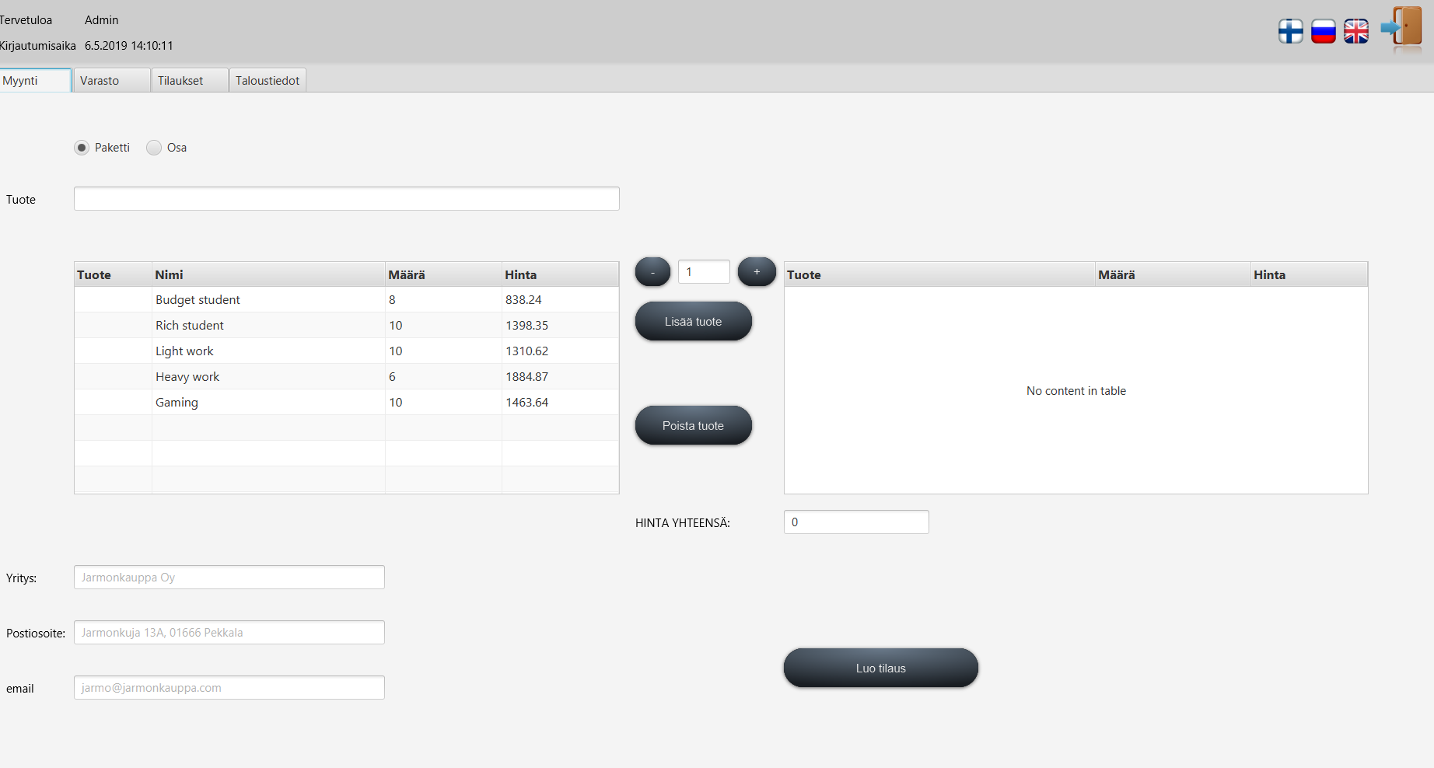
Easy warehouse management

Slide 2






Technologies
JDK 8
Maven
Hibernate
MariaDB
JavaFX
For testing:
Jenkins
TestFX
JUnit 5

Slide 3

New requirements
Localization
Building computers from parts
Adding information to products
Searching
Refactoring code
User friendly layout

Slide 4
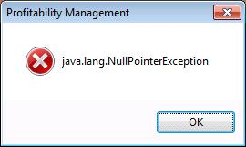
Problems
Time with other courses
Duplicate variable and method names
Problems with git
Merging
Check if text is used often before creating separate localization field for each of them
Table associations

Slide 5

What we learned
Hibernate
Refactoring code
Testing software
Scheduling
Megatons of code

